Slide 1

SPARK

Slide 2
CONTENTS
Bucketing
Sorting and Partitioning

Slide 3
Bucketing
Bucketing is a technique in both Spark and Hive used to optimize the performance of the task.
In bucketing buckets (clustering columns) determine data partitioning and prevent data shuffle.
Based on the value of one or more bucketing columns, the data is allocated to a predefined number of buckets.

Slide 4
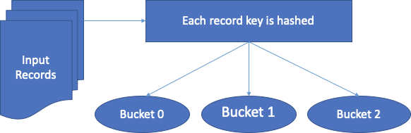
When we start using a bucket, we first need to specify the number of the buckets for the bucketing column (column name).
At the time of loading, the data processing engine will calculate the hash value for that column, based on which it will reside in one of the buckets.
Although not mandatory, using a partitioned table to do the bucketing will give the best results.

Slide 5
Bucketing has two key benefits:
Improved query performance: At the time of joins, we can specify the number of buckets explicitly on the same bucketed columns. Since each bucket contains an equal size of data, map-side joins perform better than a non-bucketed table on a bucketed table. In a map-side join, the left-hand side table bucket will exactly know the dataset contained by the right-hand side bucket to perform a table join in a well-structured format.
Improved sampling: The data is already split up into smaller chunks so sampling is improved.

Slide 6
Bucketing involves sorting and shuffling the data prior to the operation which needs to be performed on data like joins.
Bucketing boosts performance by sorting and shuffling data before performing downstream operations, such as table joins.
This technique benefits dimension tables, which are frequently used tables containing primary keys.
It’s also beneficial when there are frequent join operations requiring large and small tables.

Slide 7
Bucketing is commonly used to optimize the performance of a join query by avoiding shuffles of tables participating in the join.
It is beneficial to bucketing when pre-shuffled bucketed tables are used once within the query.
When we enable the buckets, it is critical that we specify the bucket number, for this, one needs to have an insight into the data.
Alternatively, we can perform a hit and try to get the best number of buckets.
Alternatively, we can start with the number that is the same as the number of the executor we have in our cluster and then adjust it till we get the best performance.

Slide 8
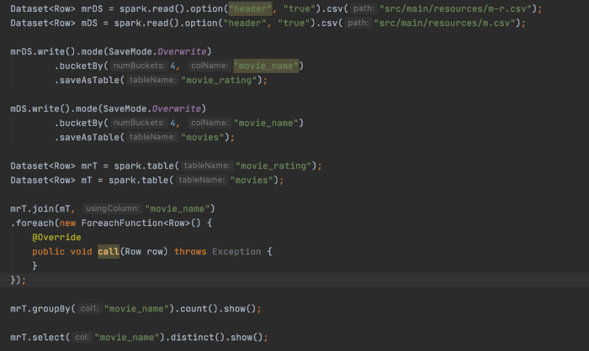
Spark DAG stages analysis With Bucketing
We are creating the two datasets from bucketed tables and then performing a join, groupBy, and distinct transformations.

Slide 9
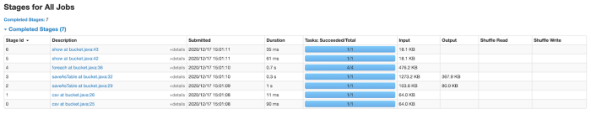
To do the bucketing, we are creating tables with a bucket (number of bucket and bucket column name), and then performing join and other transformations.
From the above screenshot, we can see that each of the jobs has one stage. In this case, a shuffle happened when creating the bucketed table .i.e., only once.

Slide 10
Advantages of Bucketing the Tables in Spark
Optimized tables/Datasets.
Optimized Joins when you use pre-shuffled bucketed tables/Datasets.
Enables more efficient queries when you have predicates defined on a bucketed column.
Optimized access to the table data. You will minimize the table scan for the given query when using the WHERE condition on the bucketing column.
Similarly, you can distribute the data across various buckets hence optimal access to table data.
Transformations that require data shuffle will be benefited.

Slide 11
Spark SQL bucketing limitations:
The bucketing technique in Spark SQL is different from Hive which gives way to an expensive migration process from Hive to Spark SQL.
Spark SQL bucketing requires sorting on reading time which greatly degrades the performance.
When Spark writes data to a bucketing table, it can generate tens of millions of small files that are not supported by HDFS.
Bucket joins are triggered only when the two tables have the same number of buckets.
It needs the bucket key set to be similar to the join key set or grouping key set.

Slide 12
The below transformations will be benefited by bucketing:
Joins
Distinct
groupBy
reduceBy

Slide 13
We should use bucketing when we have multi-joins and/or transformations that involve data shuffling and have the same column in joins and/or in transformation as we have in a bucket.
We don’t require bucketing if we do not have the same column in joins/transformations and buckets.

Slide 14
Sorting
Sorting a Spark DataFrame is probably one of the most commonly used operations.
You can use either sort() or orderBy() built-in functions to sort a particular DataFrame in ascending or descending order over at least one column.
Even though both functions are supposed to order the data in a Spark DataFrame, they have one significant difference.

Slide 15
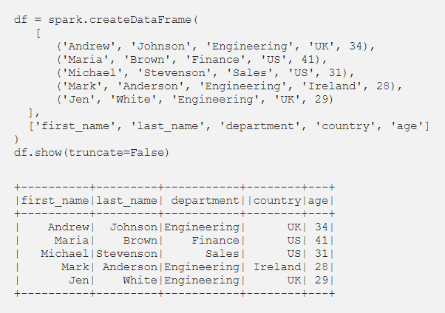
First let’s create an example DataFrame that will use throughout the article to demonstrate how both sort() and orderBy() work.

Slide 16
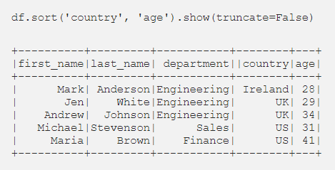
sort()
Now we can use sort() method do sort the DataFrame df based on the country and age of the employees in ascending order.

Slide 17
sort() method will sort the records in each partition and then return the final output which means that the order of the output data is not guaranteed because the data is ordered on partition-level but your DataFrame may have thousands of partitions distributed across the cluster.
Since the data is not collected into a single executor the sort() method is efficient thus more suitable when sorting is not critical for your use-case.

Slide 18
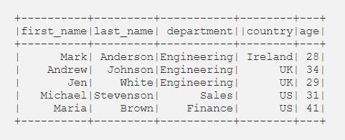
For example, if employees Jen and Andrew are stored on a different partition the final order may have been wrong, for instance:

Slide 19
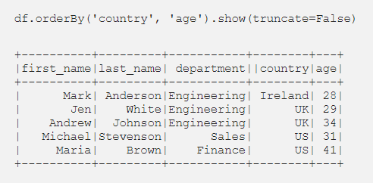
orderBy()
In the same way we can use orderBy() to order our DataFrame based on the country and age of the employees in ascending order:

Slide 20
Unlike sort(), the orderBy() function guarantees a total order in the output.
This happens because the data will be collected into a single executor in order to be sorted.
This means that orderBy() is more inefficient compared to sort().

Slide 21
Both sort() and orderBy() functions can be used to sort Spark DataFrames on at least one column and any desired order, namely ascending or descending.
sort() is more efficient compared to orderBy() because the data is sorted on each partition individually and this is why the order in the output data is not guaranteed.
On the other hand, orderBy() collects all the data into a single executor and then sorts them.

Slide 22
This means that the order of the output data is guaranteed but this is probably a very costly operation.
Therefore, if you need to sort a DataFrame where the order is not so critical and at the same time you want it to be as fast as possible then sort() is more suitable.
In case the order is critical, make sure to use orderBy() that guarantees that the output data is ordered based on the user parameters.

Slide 23
Partitioning
Resilient Distributed Datasets are collection of various data items that are so huge in size, that they cannot fit into a single node and have to be partitioned across various nodes.
Spark automatically partitions RDDs and distributes the partitions across different nodes.
A partition in spark is an atomic chunk of data (logical division of data) stored on a node in the cluster. Partitions are basic units of parallelism in Apache Spark.
RDDs in Apache Spark are collection of partitions.

Slide 24
Characteristics of Partitions in Apache Spark
Every machine in a spark cluster contains one or more partitions.
The number of partitions in spark are configurable and having too few or too many partitions is not good.
Partitions in Spark do not span multiple machines.

Slide 25
Partitioning is an important concept in apache spark as it determines how the entire hardware resources are accessed when executing any job.
In apache spark, by default a partition is created for every HDFS partition of size 64MB. RDDs are automatically partitioned in spark without human intervention, however, at times the programmers would like to change the partitioning scheme by changing the size of the partitions and number of partitions based on the requirements of the application.
For custom partitioning developers have to check the number of slots in the hardware and how many tasks an executor can handle to optimize performance and achieve parallelism.

Slide 26
Some acclaimed guidelines for the number of partitions in Spark are as follows-
When the number of partitions is between 100 and 10K partitions based on the size of the cluster and data, the lower and upper bound should be determined.
The lower bound for spark partitions is determined by 2 X number of cores in the cluster available to application.
Determining the upper bound for partitions in Spark, the task should take 100+ ms time to execute. If it takes less time, then the partitioned data might be too small or the application might be spending extra time in scheduling tasks.

Slide 27
Types of Partitioning in Apache Spark
Hash Partitioning in Spark
Range Partitioning in Spark
Hash Partitioning in Spark
Hash Partitioning attempts to spread the data evenly across various partitions based on the key. Object.hashCode method is used to determine the partition in Spark as partition = key.hashCode () % numPartitions.

Slide 28
Range Partitioning in Spark
Some Spark RDDs have keys that follow a particular ordering, for such RDDs, range partitioning is an efficient partitioning technique.
In range partitioning method, tuples having keys within the same range will appear on the same machine.
Keys in a range partitioner are partitioned based on the set of sorted range of keys and ordering of keys.
Spark’s range partitioning and hash partitioning techniques are ideal for various spark use cases but spark does allow users to fine tune how their RDD is partitioned, by using custom partitioner objects.

Slide 29
Custom Spark partitioning is available only for pair RDDs i.e. RDDs with key value pairs as the elements can be grouped based on a function of each key.
Spark does not provide explicit control of which key will go to which worker node but it ensures that a set of keys will appear together on some node.
For instance, you might range partition the RDD based on the sorted range of keys so that elements having keys within the same range will appear on the same node or you might want to hash partition the RDD into 100 partitions so that keys that have same hash value for modulo 100 will appear on the same node.

Slide 30
How to set partitioning for data in Apache Spark?
RDDs can be created with specific partitioning in two ways –
Providing explicit partitioner by calling partitionBy method on an RDD,
Applying transformations that return RDDs with specific partitioners. Some operation on RDDs that hold to and propagate a partitioner are-
Join
LeftOuterJoin

Slide 31
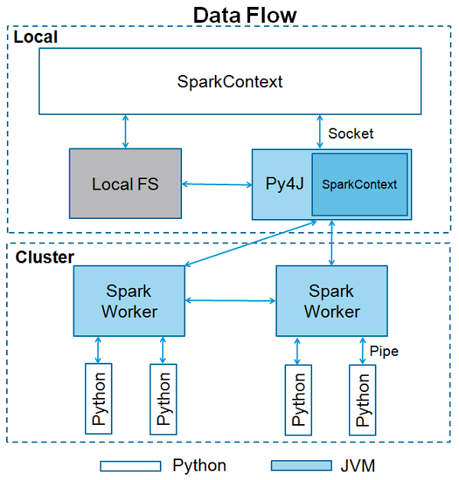

Slide 32
RightOuterJoin
groupByKey
reduceByKey
foldByKey
sort
partitionBy
foldByKey

Slide 33
END OF SESSION
Q&A

